Slide 1
Overview of the JPSS Proving Ground and S-NPP/JPSS R2O Activities
Second Suomi NPP Applications Workshop
Arron L. Layns, Mitch Goldberg and Bill Sjoberg
Joint Polar Satellite System Program Science National Environmental Satellite, Data, and Information Service National Oceanic and Atmospheric Administration November 20, 2014

Slide 2
What is the Proving Ground & Risk Reduction Program for JPSS?
The JPSS Proving Ground and Risk Reduction (PGRR) program’s primary objective is to maximize the benefits and performance of NPP/JPSS data, algorithms, and products for downstream operational and research users (gateways to the public) through:
Engaging users to enhance/improve their applications through the optimal utilization of JPSS data.
Education, Training and Outreach
Facilitating transition of improved algorithms to operations.
Detailed characterization of data attributes such as uncertainty (accuracy and precision) and long-term stability
Provides user feedback to the cal/val program

Slide 3
Proving Ground Includes Risk Reduction
Proving Ground
Demonstration and utilization of data products by the end-user operational unit, such as a NWS Weather Forecast Office , Modeling Center and National Ocean Service….
Promote outreach and coordination of new products with the end users, incorporating their feedback for product improvements
Risk Reduction
Development of new research and applications to maximize the benefits of JPSS satellite data
Example - use of Day Night Band for improved fog and low visibility products at night, benefiting transportation industry.
Encourages fusion of data/information from multiple satellite, models and in-situ data
Address potential risk in algorithms and data products by testing alternative algorithms.

Slide 4
JPSS Proving Ground and Risk Reduction Application Areas
Weather Forecasting - Improving Global, Regional forecasts
Tropical Cyclones
Severe Weather (Nowcasting)
Ocean/Coastal - Coral Bleaching, Harmful Algal Bloom alerts
Land - Droughts, Agriculture
Hazards - Smoke, Fire, Volcanic Ash, Air Quality
Hydrological - Precipitation, Floods, Soil Moisture, Snow/Ice, River Ice
Climate - Integrated products, real-time anomaly products
Education and Training
Infrastructure - Direct Readout + Software (CSPP), Airborne campaigns
JPSS Proving Ground Partners :
NWS, NOS, NMFS, OAR, NESDIS, NOAA Cooperative Institutes, NASA, and NRL

Slide 5
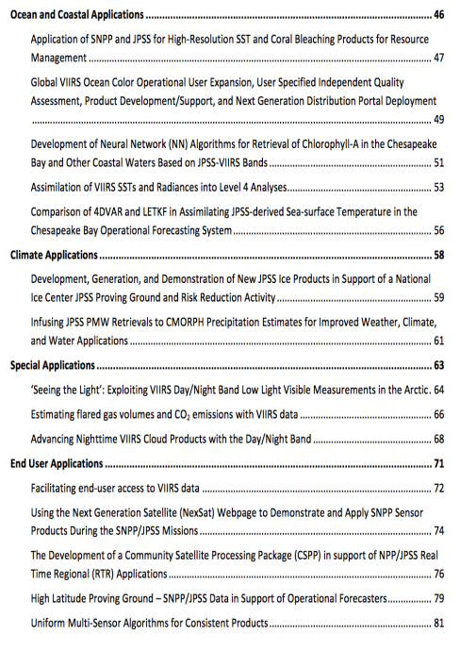
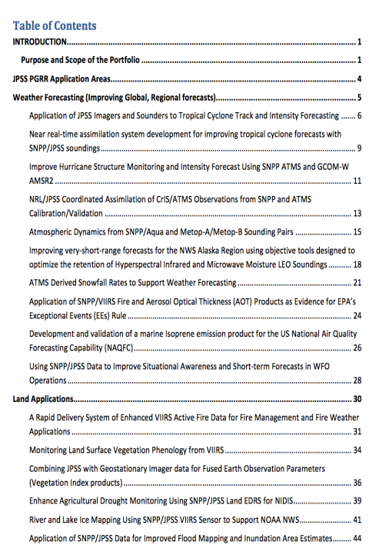
The JPSS PGRR
Portfolio

Slide 6
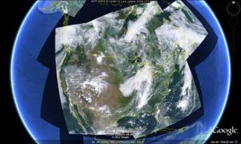
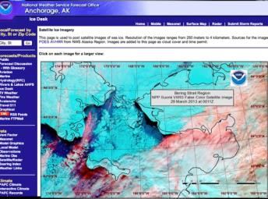
Some major PGRR Achievements
S-NPP Direct Broadcast for Alaska, Hawaii, Continental US, and World Wide Users
Routine use of VIIRS Imagery by forecast offices (significant use by Alaska)
VIIRS Active Fire, Air Quality, and Ocean Color imagery and data portals
Tropical Cyclone Forecasting Improvements using ATMS and CrIS
Global Data Assimilation Experiments of ATMS and CriS (ATMS and CrIS are used operationally)
Education and Training (New COMET VIIRS Day Night Module)
First Airborne Validation Campaign via NASA ER2
Success of inaugural River Ice and Flooding Proving Ground Initiative (PGI) resulted in a formal PGI Program and eight additional proposed initiatives

Slide 7
Proving Ground Initiatives
River Ice and Flooding
Fire and Smoke
NOAA Unique CrIS/ATMS Processing System (NUCAPS)
NWP impact studies (via HRRR and GFS) and other critical weather applications
JPSS AWIPS at National Centers
JPSS OCONUS AWIPS Initiatives including intelligence layering
Cryosphere Initiative – hydrological models
Land Data Assimilation
Ocean and Coastal
Atmospheric Chemistry
Aerosol Data Assimilation
Innovation

Slide 8
River Ice and Flooding Initiative
Initiative began in Nov 2013
Initiative Objectives
Test new River Ice and Flooding Products in operational River Forecast Center (RFC) environments
Determine the value of these products in their use in response to real-world ice jam and flooding events
Implement procedures to transition these research capabilities to operations
Initiative has high interest in NWS River Forecast Centers (RFCs)
Alaska-Pacific and North Central RFCs partners in initial actions
Northeast and Missouri Basin RFCs new 2014 partners
Two more RFCs considering joining the initiative
Products available from Direct Broadcast data through The Community Satellite Processing Package (CSPP) to RFC Systems
Products evaluated during Winter 2013-14 Project
Flooding Product has been applied year-round to US and international river basins (Paraguay request)
Notes:
RFCs identified significant value and future potential for the River Flooding Product for river forecasting applications.
Additional benefits quickly recognized in monitoring extent of snow cover and levee breaches.
Algorithm updates for both products handled issues identified during Projects
Societal Impacts:
One of the most common hazards in the U.S.
Year round threat - More than 8 million people live in areas at risk of coastal flooding
Strong need for near-real-time monitoring the evolution and dynamics of ice cover
Better risk assessment
Timely issuance of flood warnings
Faster preventive or mitigation measures
Capabilities Needed
Evaluate state of river ice to prepare for break-up
Monitor precipitation rates and ground saturation
Identify flooding caused by ice jam or rainfall in remote and urban areas
Estimate extent and depth of flooding waters

Slide 9
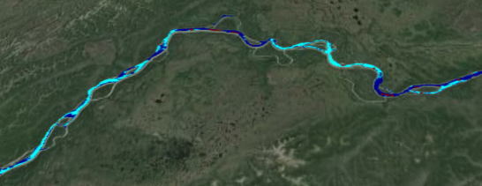
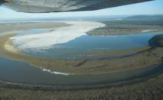
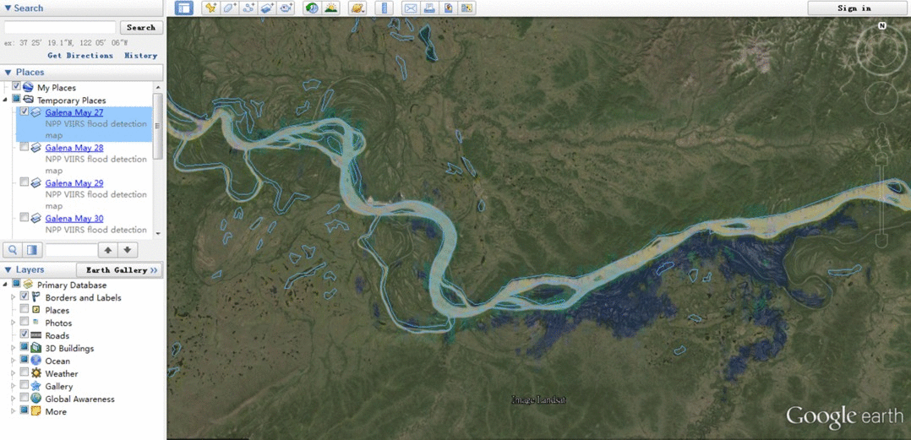
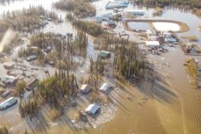
VIIRS River Ice and Flood Products
05/27/2013
VIIRS can identify river ice jams which can lead to large flood events
Flooding from ice jams can occur in a very short time
Cyan is mixed ice/water
Blue is water
Red is cloud
Yellow is solid ice
Flood extent
Galena, Alaska on
May 28, 2013
Notes:
In addition to monitoring flooding after the fact, VIIRS has the capability to detect ice jams prior to flooding.
Last year in Galena, Alaska, there was a major flooding event. On May 27, there was no flooding, but VIIRS was able to see areas of potential ice jams. The next day (as you can see in the animation) there was extensive flooding. During the peak on May 30, the extent was about 18 miles.
We have a proving ground project with Alaska weather forecast and river office to demonstrate the use of VIIRS for earlier detection. Ideally, VIIRS will see some features which would trigger a closer look using aircraft. The inset picture above is an aerial shot of the jam area which built up upstream pressure and caused the flooding the next day.

Slide 10
River Ice and Flooding Initiative NWS RFC Areas of Responsibility

Slide 11
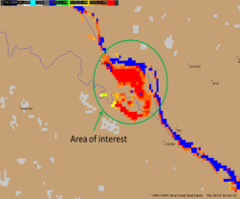
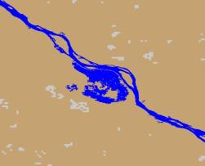
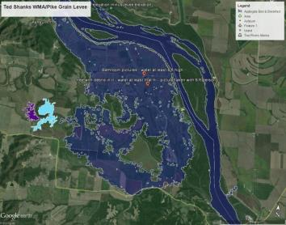
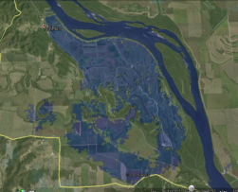
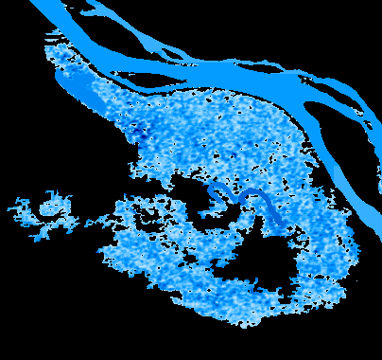
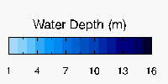
Ted Shanks Wildlife Management Area (Missouri) Flooding
River Ice and Flooding Initiative
Notes:
RFC Forecaster site visit in Sept.
Obtain high water field survey data from WMA manager
Compare volume estimate from field survey to VIIRS estimate

Slide 12
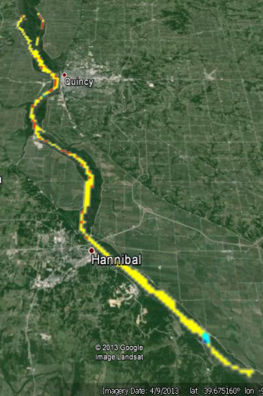
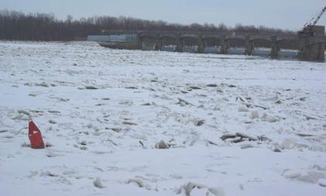
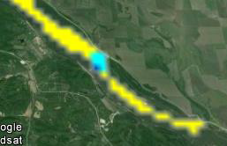
River Ice and Flooding Initiative
Hanibal MO Ice Jam (Jan-Feb 2014)

Slide 13
Fire and Smoke Initiative
Initiative began in May 2014
Initiative Objectives
Evaluate the current use of geostationary and polar orbiting satellite capabilities in support of Fire and Smoke detection and forecasting mission
Identify current SNPP/JPSS and new GOES-R data and capabilities with the potential to improve support to this mission
Establish methodologies and procedures for the operational demonstrations of these capabilities
Identify the satellite capabilities whose operational impacts are sufficient to warrant transition from research to operations
Focus has been on Western Region high risk fire areas
Includes both JPSS and GOES-R program capabilities

Slide 14
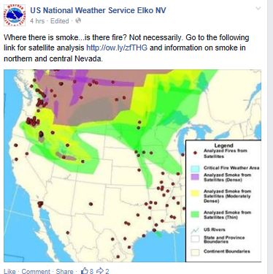
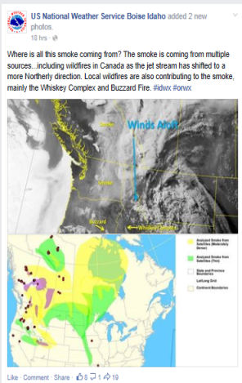
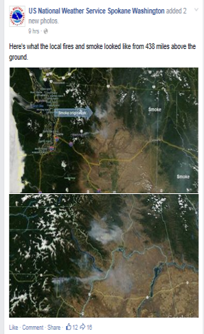
How WFOs Currently Use Satellite Imagery
Fire and Smoke Initiative

Slide 15
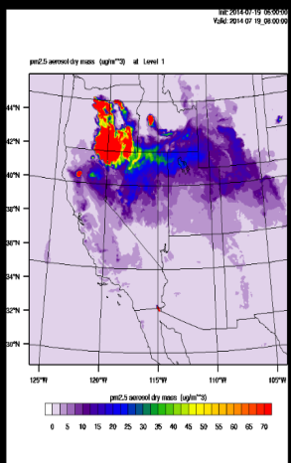
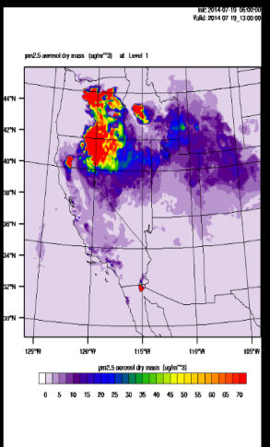
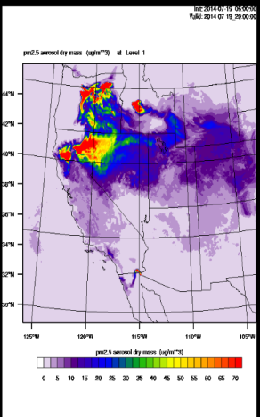
HRRR Smoke Product
Fire and Smoke Initiative
Weak east-west frontal boundary from northern UT to northern CA -- smoke from fires get caught up along front -- verified pretty well

Slide 16
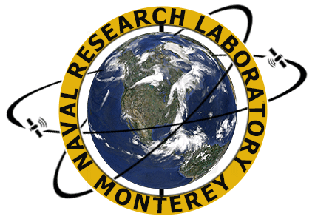
Fire and Smoke Initiative
King Fire Views via SNPP VIIRS DNB Night Time Visible
Notes:
Acknowledgments:
Naval Research Laboratory, Marine Meteorology Division, Monterey, CA
Satellite Meteorological Applications Section
Jeremy Solbrig, Mindy Surratt, Kim Richardson, Arunas Kuciauskas, and Jeff Hawkins
CIRA: Steve Miller
Sponsor: NOAA/JPSSS Program Office

Slide 17
Summary
The JPSS PGRR Program has proven its value as it goes in to its 3rd year of operations
Project teams have shown they can respond to high-visibility, rapidly changing environmental crises
The success of early Proving Ground Initiatives have encouraged the creation of additional ones
VIIRS imagery has become a staple of satellite images used by national media
SNPP success stories continue to be documented on the JPSS Website and in articles and seminars strengthening user advocacy (http://www.jpss.noaa.gov/)

Slide 18
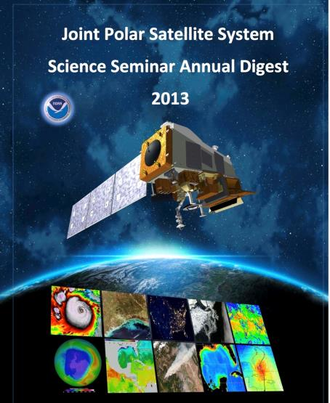
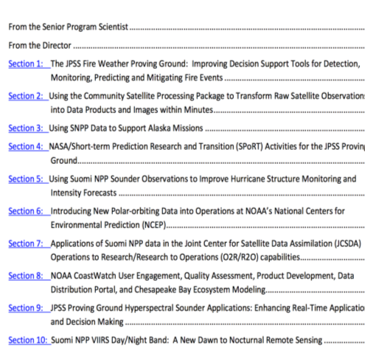
Monthly Science Seminars to
discuss PGRR topic areas
www.noaa.jpss.gov

Slide 19
Back-up Additional JPSS Highlights

Slide 20
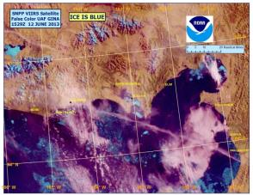
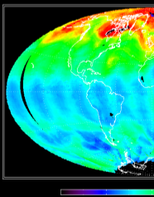
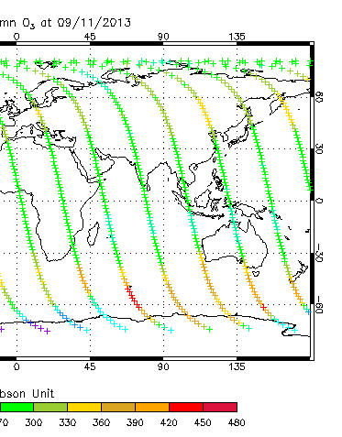
Operational Use of S-NPP Data S-NPP is now NOAA’s Primary Satellite
May 1, 2012, VIIRS imagery used to support local warning and forecast operations throughout the NWS Alaska Region.
May 22, 2012, the Advanced Technology Microwave Sounder (ATMS) radiances were operationally assimilated in the National Centers for Environmental Prediction’s (NCEP)/ NWS Global Forecast System (GFS).
September 25, 2012, ATMS data was assimilated operationally into the European Centre for Medium-Range Weather Forecasts (ECMWF) weather forecast models.
April 2013, the United Kingdom Meteorology Office began assimilating operational data from the Cross-track Imaging Radiometer Suite (CrIS) and ATMS into its weather forecast models.
August 20, 2013, NCEP began incorporating S-NPP CrIS satellite data operationally into the GFS.
October 31, 2013, NCEP/CPC started to use OMPS Ozone operationally
November, 2013, NRL started to use ATMS operationally in their global forecast model.

Slide 21
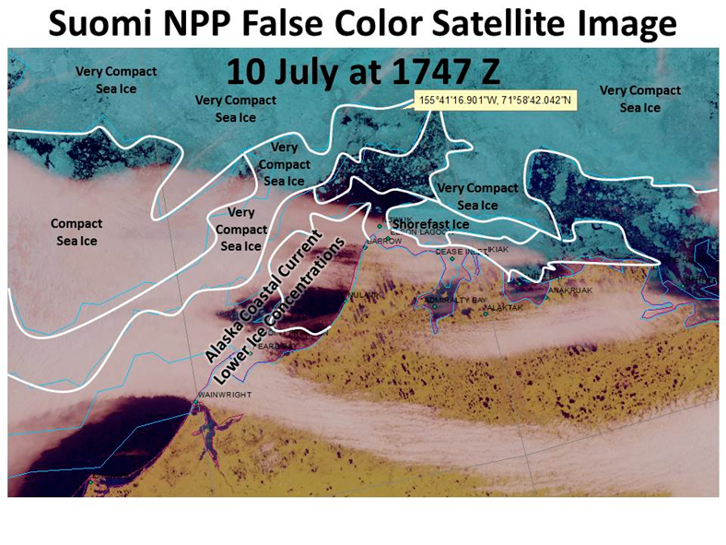
Rescue of Sailboat in Bering Sea
VIIRS false color images used by AK Ice Desk to help Coast Guard respond to May Day Call .

Slide 22
National Ocean Service

Slide 23
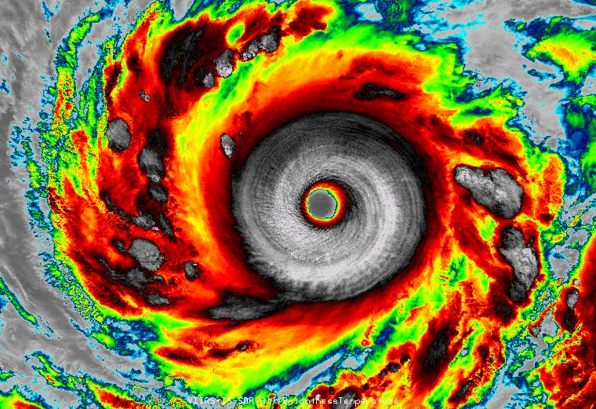
Super Typhoon Vongfong
Infrared VIIRS – 1:03on EDT on 7 Oct 2014

Slide 24
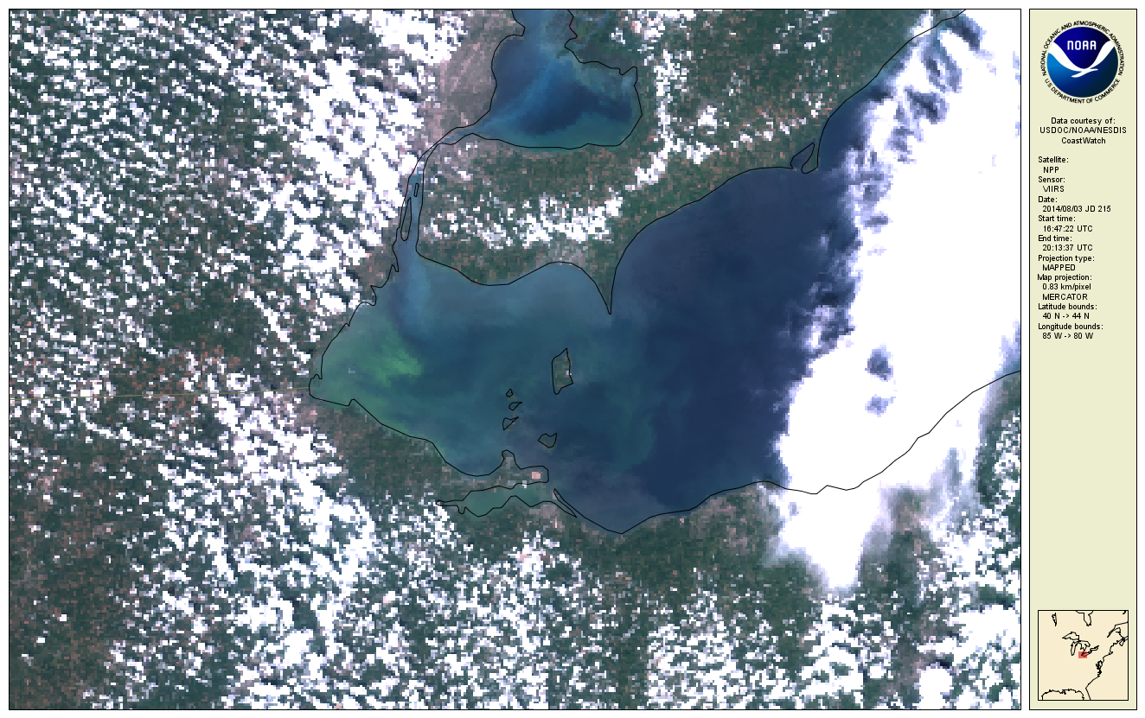
Lake Erie Algal Bloom
VIIRS coastal true color image of Lake Erie for 3 Aug 2014,
depicting the large bloom of the cyanobacterium, Microcystis sp. threatened the water supply of Toledo, OH

Slide 25
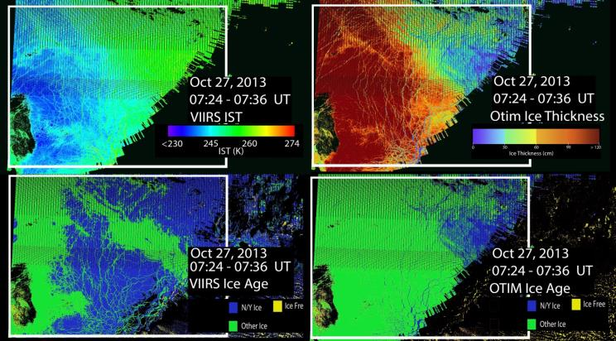
VIIRS Cryosphere Products
Comparisons between VIIRS sea ice characterization EDR and OTIM ice thickness and age products for 27 October 2013 at 07:24-07:36 UTC.

Slide 26
Process for Future PGRR Initiatives
PGI working group has developed a project roadmap which is under review by the principal PGI stakeholder(s) and members of the Satellite Program Science staff.
One page initial proposals will be requested from the startup PGI team covering the end-to-end process to meet the roadmap objectives
Encourage coordination of the proposals
PGI Stakeholder(s), Program Science will review initial proposals and select the proposals that best match user needs
Program Science will request full proposals and select the proposal that has the highest probability of success
Use this process to guide actions being taken in current PGRR initiatives and the creation of future initiatives

